Slide 1

Employee Attrition
Huy Truong
Sameera Epari
Shubham
Kothari
Nikhil
Shah
Naveen
Kumar
Shwana
Ali

Slide 2
Data Preparation
Import
Import data
1470 observations
35 variables
Check
Check missing values
No missing values
Remove
Remove unwanted variables
Variables contain one value across observations
After removal, we have 31 variables
Transform
Transform data type
Convert categorical variables to factor

Slide 3
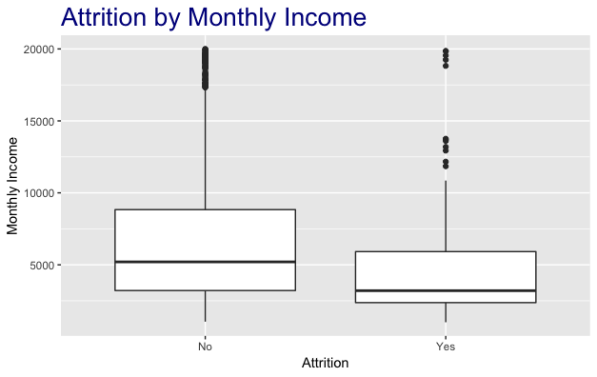
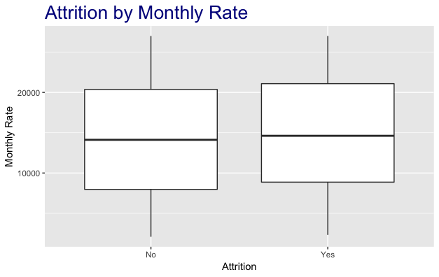
Data Exploration
Employees with low monthly income have a higher attrition rate.
Monthly Rate does not make any difference in terms of attrition rate.

Slide 4
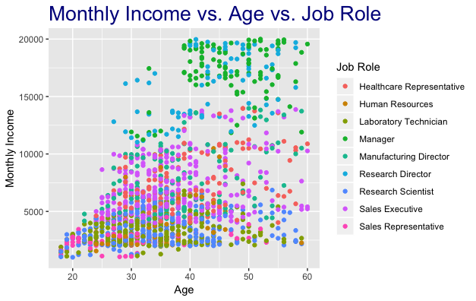
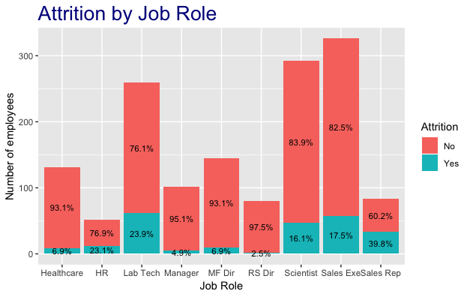
Data Exploration
Directors and Managers have a higher monthly income, compared to others.
Lab Tech, Sales Rep, and HR have a higher attrition rate.

Slide 5
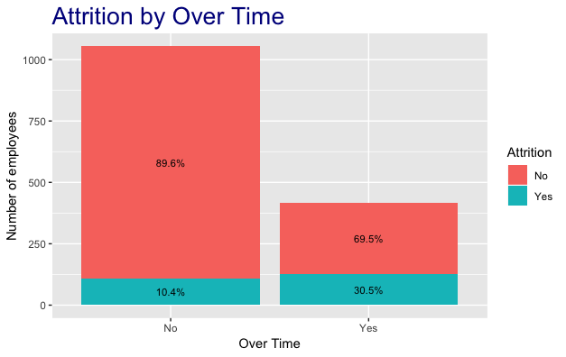
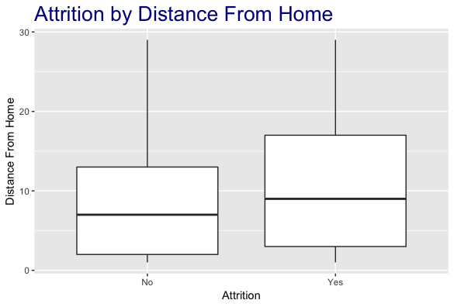
Data Exploration
Employees with high over time have a higher attrition rate.
More the distance from home, higher the attrition rate.

Slide 6
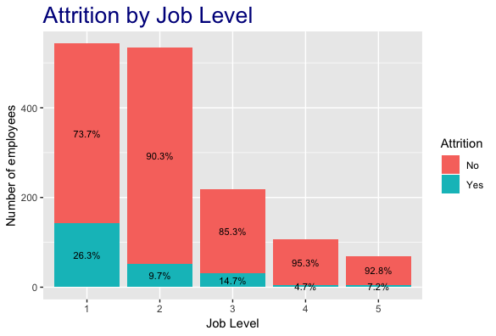
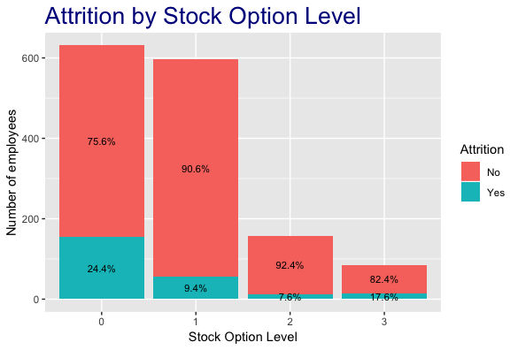
Data Exploration
Employees with low job level have a higher attrition rate.
Employees with low stock option level have a higher attrition rate.

Slide 7
Modelling
Organize Data
Divide the data into training and test set.
Apply SMOTE to handle imbalance in the training set.
Select Predictors
Apply LASSO to pull out significant predictors.
Remove insignificant predictors from the dataset.
Build Model
Random Forest.
Support Vector Machine.
Logistic Regression.
Naïve Bayes.
Linear Discriminant Analysis.
Gradient Boosting Machine.

Slide 8
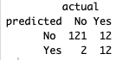
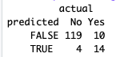
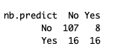
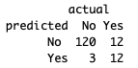
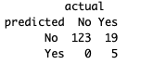
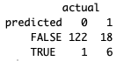
ModelLing
LDA – 0.9047
Logistic – 0.9047
NaiveBayes - 0.8367
SVM – 0.8979
Ran.Forrest – 0.8707
GBM – 0.8707

Slide 9
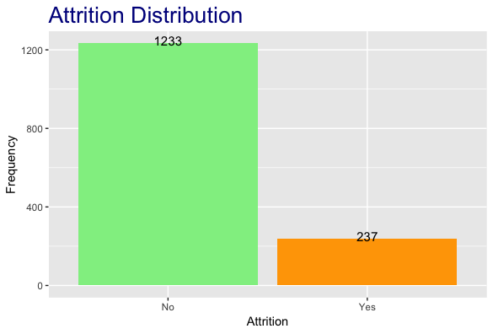
modelling
Data is imbalanced between two classes of response.
This may bias our prediction.
We applied SMOTE to balance the data.

Slide 10
AFTER BALANCING

Slide 11
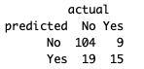
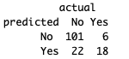
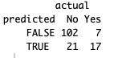
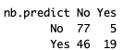
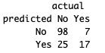
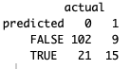
Modelling
RANDOM FORREST
SVM
LOGISTIC
Accuracy -0.8095
Accuracy -0.8095
Accuracy -0.8095
NAIVE BAYES
LDA
BOOSTING(GBM)
Accuracy -0.6530
Accuracy -0.7823
Accuracy -0.7959

Slide 12
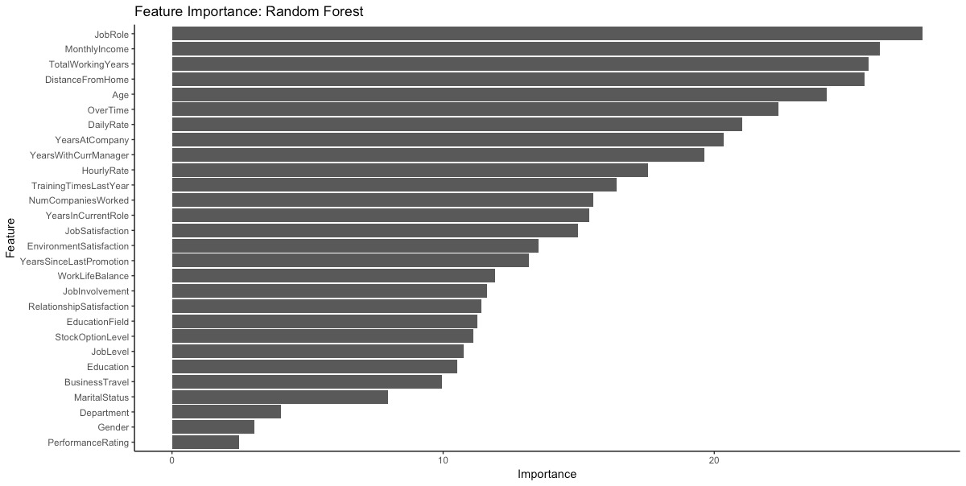
Feature Importance

Slide 13
Modelling roc curve
SVM (red line) generates the best ROC curve.

Slide 14
recommendation
Increase salary/update incentive scheme.
Promote.
Reduce work load/invest in automation.
Offer stock option.
Provide allowance for transportation/offer work-from-home.

